Slide 1

Retail Sim References
Steve Berthiaume

Slide 2

Historical Reference – Richard Serra
Richard Serra is an American sculptor with a storied career, dating back to the sixties. His work involves metalwork, drawing from his experience in shipbuilding and steel mills.

Slide 3
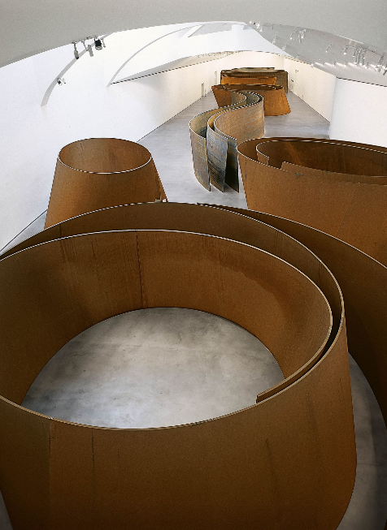
Historical Work – The Matter of Time – Richard Serra (1994-2005)
The Matter of Time is one of the more recent works made by Serra. The installation involves exploring a dizzying space made of his sculptures.

Slide 4
Historical Link
While Serra’s work is admittedly relatively recent, it can be rather difficult to access information about artists which falls outside of their creative practice. Serra’s work experience helped inform his practice in a way I hope to emulate.

Slide 5
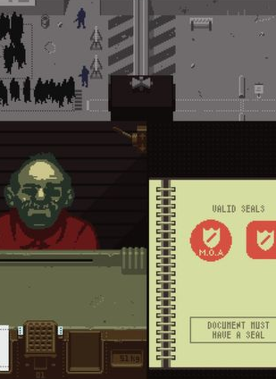
Contemporary Reference – Papers Please
Papers Please is a game developed by Lucas Pope which satirizes the life of border patrol agents through a dystopic lens.

Slide 6
Contemporary Link
While the work is very different, I find the ability of Papers Please to put any individual in the position of a worker and give immediate sympathy and understanding for their job and the dilemmas they face very powerful. This instant empathy is an aspect I seek to implement in my own game.

